Slide 1
UNIT-II Relational Model
Mrs. Kanchan M. Bhale
VPKBIET, Baramati
kanchan.bhale@vpkbiet.org

Slide 2
Outline
Relational Model
Basic Concepts
Attributes
Domains
Keys

Slide 3
Relational Data Model
Proposed by Edgar F Codd (1923-2003) in the early seventies [ Turing Award – 1981 ]
Most of the modern DBMS use the relational data model.
Simple and elegant model with a mathematical basis.
Led to the development of a theory of data dependencies and database design.

Slide 4
Relational Schema
Consists of relation name, and a set of attributes or field names or column names.
Each attribute has an associated domain.
Example:
student ( studentName : string,
rollNumber : string,
phoneNumber : integer,
yearOfAdmission : integer,
branchOfStudy : string )
Relation Name
Attribute Name: Domain Name

Slide 5
Relation Instance
A finite set of tuples constitute a relation instance.
A tuple of the relation with scheme R = (A1, A2, … , Am) is an ordered sequence of values (v1,v2, ... ,vm) such that vi ∈ domain (Ai), 1≤ i ≤ m
Student
Relation has fixed number of attributes and variable number of tuples
studentName | rollNumber | yearofAdmission | Phoneno | branchofStudy
RaviTeja | CS181101 | 2018 | 9814056790 | CS
Rajesh | CS191100 | 2019 | 9011006543 | CS
Tuples

Slide 6
Relation Example
enrollment (studentName, rollNo, courseNo, sectionNo)
enrollment
studentName | rollNo | courseNo | sectionNo
Rajesh | CS181001 | CS3200 | 2
Rajesh | CS191002 | CS3700 | 1
Suresh | CS04B130 | CS3200 | 2

Slide 7
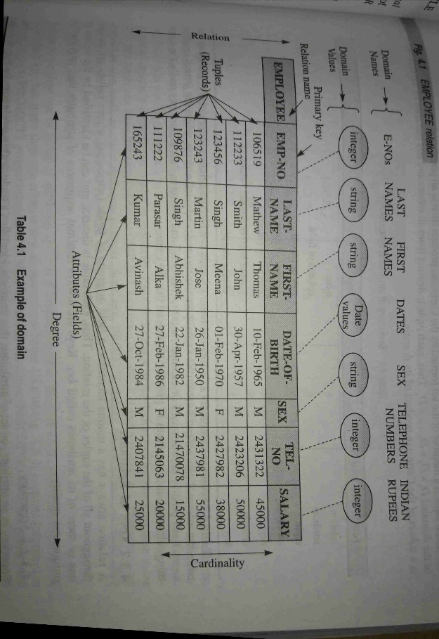

Slide 8
Structural Terminology
Formal Relational Term | Informal equivalent
Relation | Table
Attribute | Column or field
Tuple | Row or record
Cardinality | No. of rows
Degree | No. of Columns
Key | Unique Identifier
Domain | Atomic values

Slide 10
Values and Nulls in the Tuples
Each value in a tuple is an atomic value.
NULL values, which are used to represent the values of attributes that may be unknown or may not apply to a tuple.

Slide 11
Why do we need keys?
Keys help you to identify any row of data in a table. In a real-world application, a table could contain thousands of records. Moreover, the records could be duplicated. Keys ensure that you can uniquely identify a table record despite these challenges.
Help you to enforce identity and integrity in the relationship
Allows you to establish a relationship between and identify the relation between tables

Slide 12
Keys
A relation always has a unique identifier or group of fields whose value are unique throughout all of the tuples of the relation.
Each tuple can be distinct and can be identified by the values of one or more of its attributes called keys

Slide 13
Types of Keys
Super Key
Candidate Key
Primary Key
Foreign Key

Slide 14
KEYS
Instructor
Let K ⊆ R
K is a superkey of R if values for K are sufficient to identify a unique tuple of each possible relation r(R)
Example: {ID} and {ID,name} are both superkeys of instructor.
Superkey K is a candidate key if K is minimal Example: {ID} is a candidate key for Instructor
One of the candidate keys is selected to be the primary key.
which one?
Foreign key constraint: Value in one relation must appear in another
Referencing or detail relation
Referenced or master relation
Example – dept_name in instructor is a foreign key from instructor referencing department
Department

Slide 15
Properties of Candidate Key
It must contain unique values
Candidate key may have multiple attributes
Must not contain null values
It should contain minimum fields to ensure uniqueness
Uniquely identify each record in a table

Slide 16
Properties of Primary Key
Not allows duplicate values
Also not allows null values
One primary key is allowed per table
Unique index is created automatically on primary key.
A single column primary key is called simple key
A multicolumn primary key is called composite key.

Slide 17
Identify Candidate key and Primary key?
StudID | Roll No | First Name | LastName | Email
1 | 11 | Tom | Price | abc@gmail.com
2 | 12 | Nick | Wright | xyz@gmail.com
3 | 13 | Dana | Natan | mno@yahoo.com
Candidate keys:{ StudId, RollNo, Email}
Primary Key:{ StudID}

